Slide 1
Probability and Statistical Inference
Logistic Regression
Sources used in creation of this lecture:
Statistics and Data Analysis, Peck, Olsen and Devore; Discovering Statistics Using R, Field, Miles and Field; Understanding Basic Statistics, Brase and Brase;SPSS Survival Manual, Julie Pallant

Slide 2
When And Why
To predict an outcome variable that is categorical from one or more categorical or continuous predictor variables.
There are many important research topics for which the dependent variable is "limited."
E.g. Purchase or not, live or die, employ or not, commit crime or not, pass exam or not
Participation data is not continuous or distributed normally.
Used because having a categorical outcome variable violates the assumption of linearity in normal regression.
Binary logistic regression is a type of regression analysis where the dependent variable is a dummy variable: coded 0 (did not vote) or 1(did vote)

Slide 3
Logistic Regression
Logistic regression does not try to predict the value of a numeric variable given a set of inputs.
Instead, the output is a probability that the given input point belongs to a certain class or category.

Slide 4
Logistic Regression
Suppose that we have only two classes (positive or negative)
The probability in question is P+ =the probability that a certain data point belongs to the +ive class.
P- = 1 –P+
Thus, the output of Logistic Regression always lies in [0, 1].

Slide 5
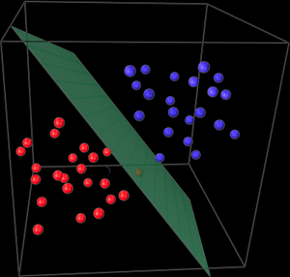
Logistic Regression
Assumption is that your input space can be separated into two nice ‘regions’, one for each class, by a linear(read: straight) boundary.
For two dimensions, this boundary is a straight line- no curving.
For three dimensions, its a plane. And so on.
If your data points do satisfy this constraint, they are said to be linear-separable.

Slide 6
Logistic Regression
Suppose we have two input variables the function corresponding to the boundary will be something like
b0+ b1x1 + b2x2.
Our output variable is not part of our space unlike linear regression
Consider a point in the space (a,b) where a is the value of x1 and b is the value of x2
b0 + b1a +b2b
Depending on the location of (a,b), there are three possibilities to consider….

Slide 7
Logistic Regression – Location of (a,b)
It lies in the region defined by points of the +ive class.
The result of our equation will be positive, lying somewhere in (0, ∞).
Mathematically, the higher the magnitude of this value, the greater is the distance between the point and the boundary.
Intuitively then it means there is a greater probability that (a,b) belongs to the +ive class. – probability between (0.5, 1].
It lies in the region defined by points of the -ive class.
The result of our equation will be negative, lying in (-∞ 0).
As for the positive case, the higher the magnitude of the value, the greater the probability that (a,b) belongs to the -ive class – probability within [0, 0.5).
It lies ON the linear boundary.
The result of our equation =0.
Means that the model cannot really say whether belongs to the +ive or -ive class.
As a result, the probability will be exactly 0.5.

Slide 8
Logistic Regression
So how do we map our outcome of the equation (values –∞ to ∞ ) to the an estimate of the likelihood of our point being in the +ive class – map to the probability?
Use the ODDS RATIO

Slide 9
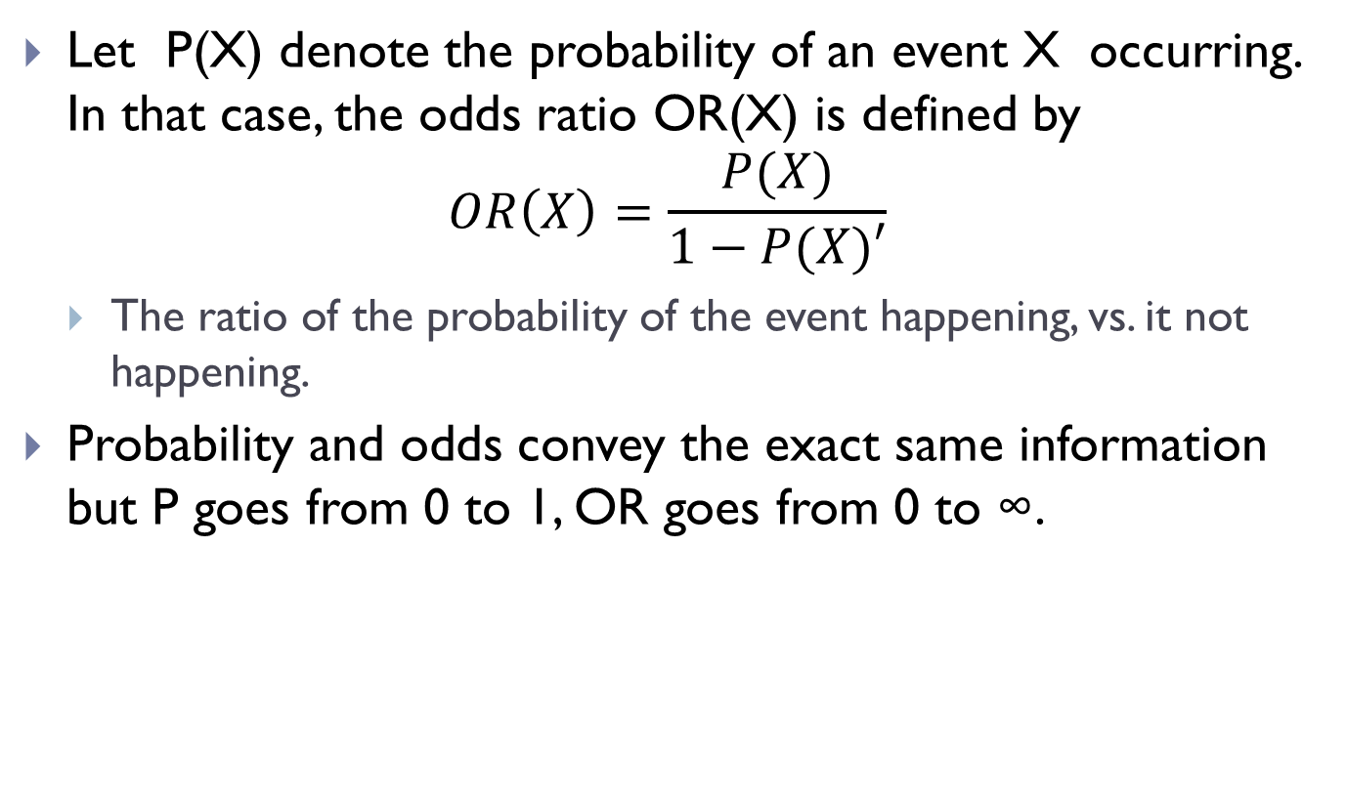
Logistic Regression
Let P(X) denote the probability of an event X occurring. In that case, the odds ratio OR(X) is defined by
$$OR\left(X\right)=\frac{P(X)}{1−P(X)′}$$
The ratio of the probability of the event happening, vs. it not happening.
Probability and odds convey the exact same information but P goes from 0 to 1, OR goes from 0 to ∞.

Slide 10
Logistic Regression
To work in the same space as our boundary equation which goes from (–∞ to ∞ ) we is take the logarithm of OR, called the log-odds function.
This is e to the power of the value of our boundary equation

Slide 11
Logistic Regression
Step 1. Compute the boundary equation(alternatively, the log-odds function) value, b0+ b1a + b2b.
Lets call this value t.
Step 2. Compute the Odds Ratio, by doing OR+ = e^{t} (Since t is the logarithm of OR+ ) – e is the base of the natural logarithm
Step 3. Knowing OR+, it is possible to compute P+

Slide 12
Logistic Regression With One Predictor
Outcome
We predict the probability of the outcome occurring
b0 and b1
Can be thought of in much the same way as regression
Note the normal regression equation forms part of the logistic regression equation

Slide 13
Logistic Function
P(“Success”|X)
X

Slide 14
Binary Logistic Regression
Binary outcome variable
Code 0 when event does not occur
Code 1 when it does
We are interested in the Odds of something happening

Slide 15
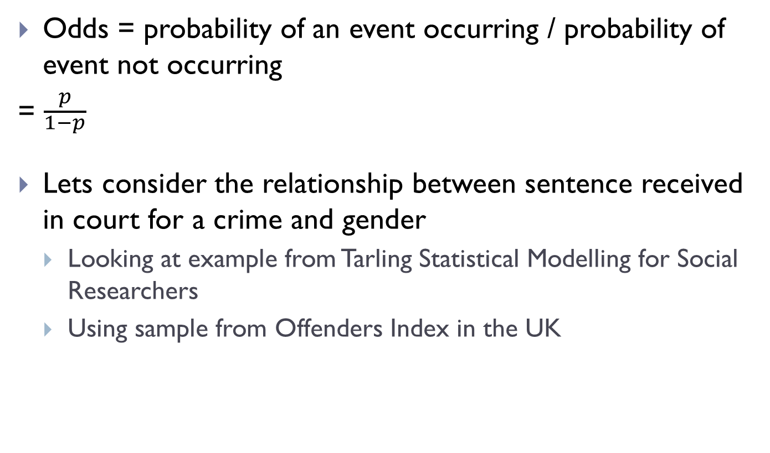
Odds ratio
Odds = probability of an event occurring / probability of event not occurring
= $\frac{p}{\begin{aligned}1−p \\ \end{aligned}}$
Lets consider the relationship between sentence received in court for a crime and gender
Looking at example from Tarling Statistical Modelling for Social Researchers
Using sample from Offenders Index in the UK

Slide 16
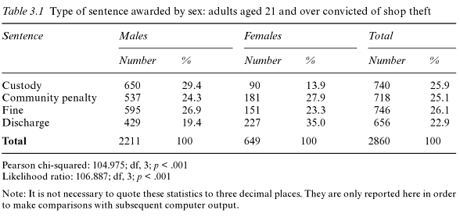
Odds ratio
Custody – some form of imprisonment
Community penalty – probation etc.
Fine – monetary penalty or compensation to victim
Discharge – either not guilty or guilty and no sentence applied (or sentence conditional on no reoffending for a period)

Slide 17
Odds ratio
There is an association between gender and sentencing from the table
Females
Less likely to receive custodial sentence13.9% receive custodial sentence, 35% are discharged
Slightly more likely to receive probation (27.9%) than be fined (23.3%)
Males
More likely to receive custodial sentence (29.4%) and less likely to be discharged (19.4%)
Similar proportions receiving probation (24.3%) and fined (26.9%)

Slide 18
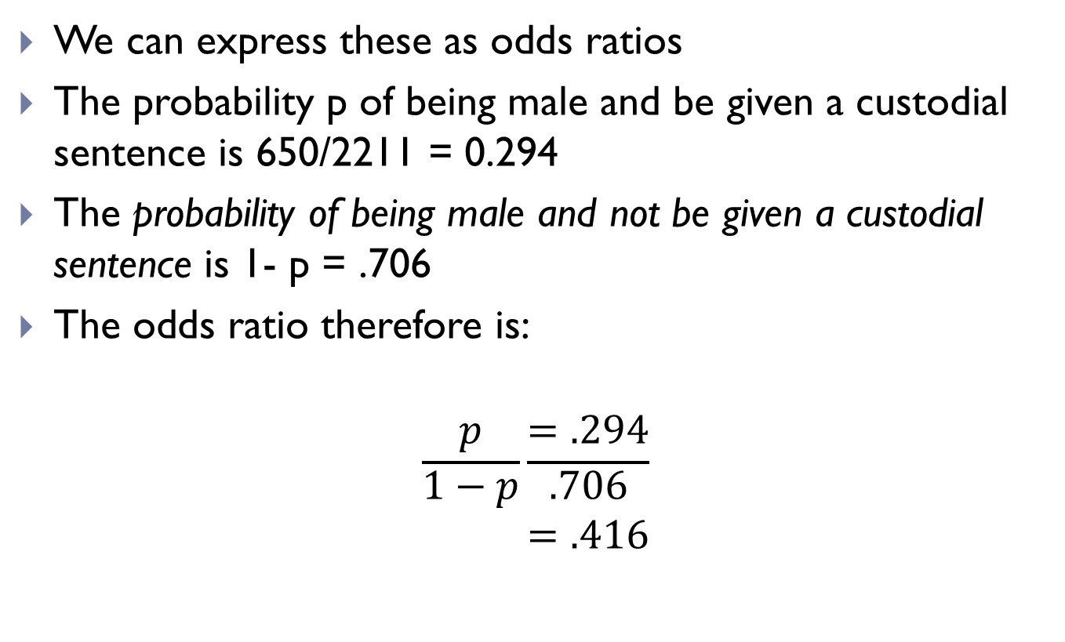
Odds ratio
We can express these as odds ratios
The probability p of being male and be given a custodial sentence is 650/2211 = 0.294
The probability of being male and not be given a custodial sentence is 1- p = .706
The odds ratio therefore is:
$$\frac{p}{\begin{aligned}1−p \\ \end{aligned}}\frac{=.294}{\begin{aligned}.706 \\ =.416 \\ \end{aligned}}$$

Slide 19

Odds ratio
$$\frac{p}{\begin{aligned}1−p \\ \end{aligned}}\frac{=.294}{\begin{aligned}.706 \\ =.416 \\ \end{aligned}}$$
The odds of being a male and not sentenced to custody is the inverse of the odds of being sentenced to custody = 1/.416=2.403
Thus males are 2.4 times more likely to receive a sentence other than custody than they are to receive a custodial sentence

Slide 20
Odds ratios
For females, probability of being given a custodial sentence is 90/649 = .139
Probability of not being given a custodial sentence is 1-.139=.861
Odds of being given a custodial sentence is .139/.861=.161
Odds of not being given a custodial sentence is .6211

Slide 21
Odds ratios
To compare males and females
Odds ratio of males to females receiving a custodial sentence = .416/.161 = 2.58
Males are 2.6 times more likely to receive a custodial sentence than females
Odds ratio of females to males receiving a custodial sentence = .161/.416 = .387
Females are 38% as likely to receive a custodial sentence as males

Slide 22
Logistic regression
Odds ratios are used to calculate probabilities in a regression
Predictor variables can be either continuous or categorical
There is no assumption of linearity between variables
It is however sensitive to high correlation between predictor variables (multicollinearity)

Slide 23
Example - Youthcohort Dataset
Taken from Quantitative Data Analysis in Education, Paul Connolly
Dataset Descriptor: http://cw.routledge.com/textbooks/9780415372985/pdfs/youthcohort.pdf
Research question: what factors predict the likelihood that a student will answer yes when asked if they sat their maths GCSE?

Slide 24
Example
Variables
Sat Maths (satmath)
0 = no, 1 = yes
Respondent gender (s1gender)
1 = male, 2=female
Highest parental qualification
1 at least one parent with a degree, 2 at least one parent with an A Level, 3 neither parent with an A Level

Slide 25
Example
You need
One categorical dependent variable – satmath
Two or more continuous or categorical variables
s1gender, s1pared (both categorical)

Slide 26
Basic Model
#Assume we have read the data into a data frame mydata
logmodel1 <- glm(satmath ~ s1gender+s1pared, data = mydata, na.action = na.exclude, family = binomial())

Slide 27
Interpreting the output
The baseline/null model is the baseline comparator to which any model is compared.
Predictions of this baseline model are made purely on whichever category occurred most often in our dataset
Our aim is to improve this prediction by including our additional variables.
Baseline/Null Model
logmodel1 <- glm(satmath ~ 1, data = mydata, family = binomial())

Slide 28
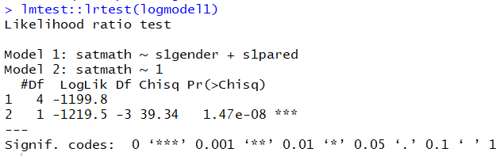
Interpreting the output
Omnibus test of model is used to check that the new model (with explanatory variables included) is an improvement over the baseline model.
It uses chi-square tests to see if there is a significant difference between the baseline model (null) and the model created
The Chi-square statistic is 39.34 df=3, which is statistically significant (p <0.001)

Slide 29
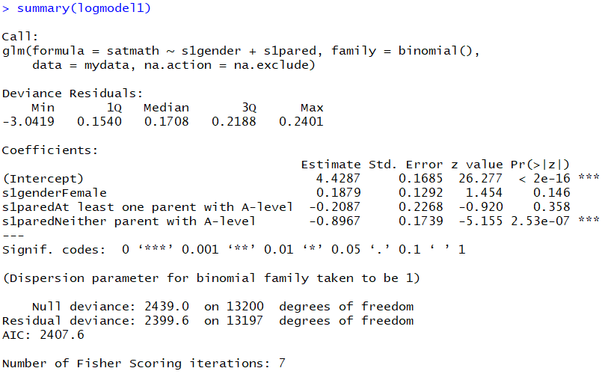
Interpreting the output
Deviance residuals, are a measure of model fit.
Used as part of the calculation of Chi square
#Chi-square
modelChi <- logmodel1$null.deviance - logmodel1$deviance
#p-value
chidf <- logmodel1$df.null - logmodel1$df.residual
chisq.prob <- 1 - pchisq(modelChi, chidf)
chisq.prob

Slide 30
Interpreting the output
The AIC loss function (2k-2*log(L)) tries handle the bias when fitting a model. When you fit a model if you increase the number of parameters you will improve the log likelihood but will run into the danger of over fitting. AIC adjusts for increasing the number of parameters. Minimizing the AIC selects the model where the improvement in log likelihood is not worth the penalty for increasing the number of parameters.

Slide 31
Interpreting the output
The z statistic or Wald statistic is calculated to get the significance of the predictor.
We can see that s1gender is not statistically significant and only one level of s1parend is significant.

Slide 32
Interpreting the output
What does this mean?
Being female, the log odds (Estimate) of answering yes to whether you sat maths at GCSE increase by 0.1879 in comparison to being male but this NOT statistically significant.

Slide 33
Interpreting the output
What does this mean?
Having neither parent with an A level , the log odds of answering yes to whether you sat maths at GCSE maths decrease by -0.8967 in comparison to having at least one parent with a degree and this is statistically significant.

Slide 34
Interpreting the output
What does this mean?
Having at least one parent with an A level , the log odds of answering yes to whether you sat maths GCSE decrease by -0.2087 in comparison to having at least one parent with a degree and this is NOT statistically significant.

Slide 35

Interpreting the output
P(Y)$=\frac{1}{1+e^{−(b0+b1X1+b2X2)}}$
You can generate the equation.
b0 is the intercept.
b1 is the coefficient of the first predictor etc…

Slide 36
The odds ratio: exp(B)
Indicates the change in odds resulting from a unit change in the predictor.
OR > 1: Predictor ↑, Probability of outcome occurring ↑.
OR < 1: Predictor ↑, Probability of outcome occurring ↓.

Slide 37
Interpreting the output
You can exponentiate the coefficients and interpret them as odds-ratios.
Now we can say that being female, the odds of answering yes to sitting maths are 1.20 when compared to being than being male.
And having neither parent with an a level, the odds of answering yes to sitting maths are 0.4079 when compared to having at lease one parent with a degree.
exp(coefficients(logmodel1))
(Intercept) 83.8207195
s1genderFemale 1.2067584
s1paredAt least one parent with A-level 0.8116561
s1paredNeither parent with A-level 0.4079235

Slide 38
Interpreting the output
The intercept represents the odds of answering yes to having sat maths for a male respondent having at least one parent with a degree.
exp(coefficients(logmodel1))
(Intercept) 83.8207195
s1genderFemale 1.2067584
s1paredAt least one parent with A-level 0.8116561
s1paredNeither parent with A-level 0.4079235

Slide 39
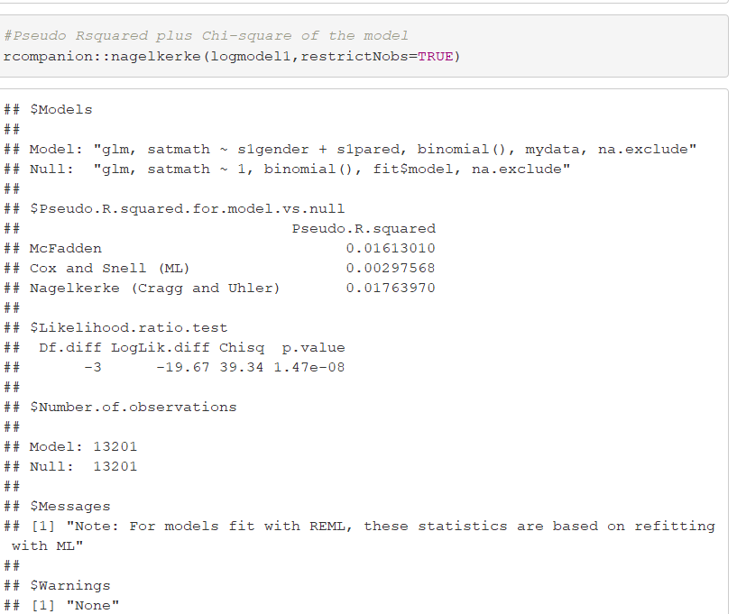
Interpreting the output
How useful is the model?
Cox and Snell R² and Nagelkerke R² are pseudo R² statistics – in this case they indicate that between 0.29% and 1.76 % of the variance in the variability of responses to they sat maths at GCSE.

Slide 40
Interpreting the model
A confusion matrix/classification matrix is a table that is often used to describe the performance of a classification model on a set of test data for which the true values are known.

Slide 41
Interpreting the output
Classification Table/Confusion Matrix provides us with an indication of how well the model can predict the correct category for each case.
Compare this to the classification for null to see the improvement.

Slide 42
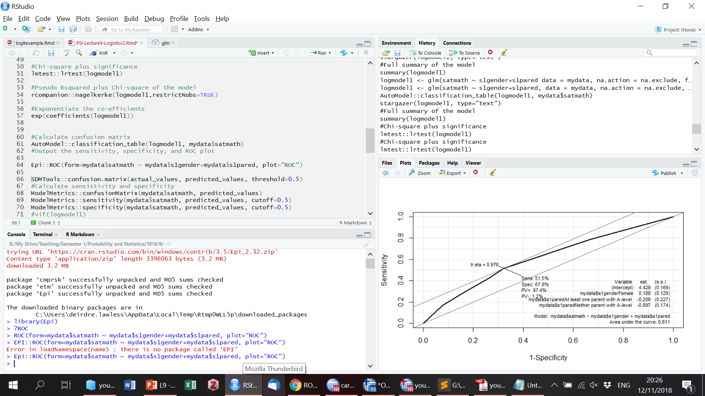
Sensitivity
#Output the sensitivity, specificity, and ROC plot
Epi::ROC(form=mydata$satmath ~ mydata$s1gender+mydata$s1pared, plot="ROC")
The sensitivity of the model is the percentage of the group with the characteristic of interest that has been accurately identified by the model
Those with "yes" for sitting mathematics correctly predicted by the model (i.e., true positives).
In this case the model was able to identify 51.5% of the people who said they sat maths.

Slide 43
Specificity
#Output the sensitivity, specificity, and ROC plot
Epi::ROC(form=mydata$satmath ~ mydata$s1gender+mydata$s1pared, plot="ROC")
The specificity of the model is the percentage of the group without the characteristic of interest
Those with "no" for sitting mathematics and were also correctly predicted as not having the observed characteristic (i.e., true negatives).
In this case 67.8%.

Slide 44
Interpreting the output
The positive predictive value is the percentage of the cases the model classifies as having the characteristic that is actually observed in this group.
Calculate by dividing the number of predicted cases yes/ the total number predicted (97.4%)
The negative predictive value is the percentage of the cases the model classifies as not having the characteristic that is actually observed in this group. (1.2%)

Slide 45
ROC Curve
Receiver Operating Characteristic.
Originates from sonar in the 1940s
Were used to measure how well a sonar signal (e.g., from an enemy submarine) could be detected from noise (a school of fish).
Used to see how any predictive model can distinguish between the true positives and negatives by plotting sensitivity, the probability of predicting a real positive will be a positive, against 1-specificity, the probability of predicting a real negative will be a positive.
The ROC curve plots out the sensitivity and specificity for every possible decision rule cutoff between 0 and 1 for a model.

Slide 46
ROC
A model that predicts at chance will have an ROC curve that looks like the lower diagonal line.

Slide 47
ROC
The further the curve is from the lower diagonal line, the better the model is at discriminating between positives and negatives in general.

Slide 48
ROC
To use the ROC curve to quantify the performance of a classifier use the Area Under the Curve. AUC is literally just the percentage of this graph that is under this curve. This AUC is 0.61 (.5 is considered weak, 0.8 strong)

Slide 49
Interpreting the output
Reporting odds ratios for categorical predictors we must remember that we are comparing the odds for two categories.
For more than two we are comparing each category to the reference category (value 0) – which we specify in the regression.
For odds ratios less than 1 we can invert these and report the inversion to help interpretation.

Slide 50
Multinomial logistic regression
Logistic regression to predict membership of more than two categories.
It (basically) works in the same way as binary logistic regression.
The analysis breaks the outcome variable down into a series of comparisons between two categories.
E.g., if you have three outcome categories (A, B and C), then the analysis will consist of two comparisons that you choose:
Compare everything against your first category (e.g. A vs. B and A vs. C),
Or your last category (e.g. A vs. C and B vs. C),
Or a custom category (e.g. B vs. A and B vs. C).
The important parts of the analysis and output are much the same as we have just seen for binary logistic regression

Slide 51
Assumptions Logistic Regression
Dependent variable must be binary for binomial, ordinal/multinomial for multinomial.
Observations to be independent of each other. In other words, the observations should not come from repeated measurements or matched data.
Little or no multicollinearity among the independent variables. This means that the independent variables should not be too highly correlated with each other.
Assess as you would for linear using vif from the car package.
Assumes linearity of independent variables and log odds. This does not require the dependent and independent variables to be related linearly, it requires that the independent variables are linearly related to the log odds.
Box-Tidwell test (in the car package) can be used.
Typically requires a large sample size. A general guideline is that you need at minimum of 10 cases with the least frequent outcome for each independent variable in your model. For example, if you have 5 independent variables and the expected probability of your least frequent outcome is .10, then you would need a minimum sample size of 500 (10*5 / .10).

